Slide 1
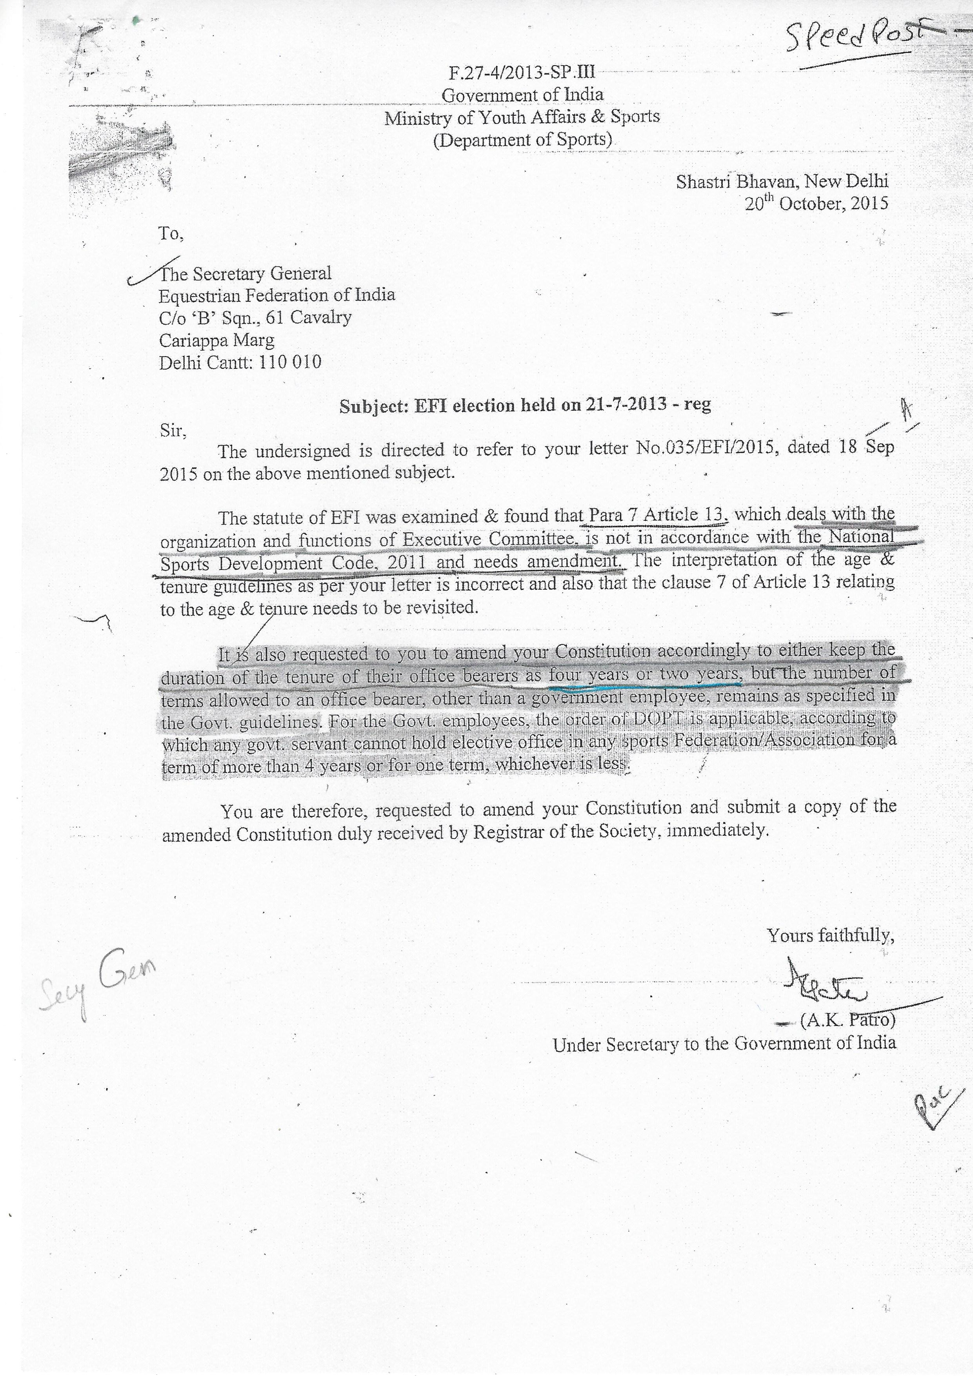

Slide 2

PAGE NO | ART NO | PARA NO | PREVIOUS | AMMENDED IN AGM 2016
20 | 013 | 7 | EACH MEMBER OF THE EXECUTIVE COMMITTEE, SHALL ASSUME HIS OFFICE ON THE FOLLOWING DAY OF THE CONCLUSION OF THE ANNUAL GENERAL ASSEMBLY MEETING IN WHICH THE ELECTIONS WERE MADE AND WILL HOLD THE OFFICE FOR A TERM OF TWO YEARS OR TILL THE NEXT ANNUAL GENERAL ASSEMBLY MEETING, WHICHEVER IS LATER. IN THE CASE OF THE PRESIDENT, SECRETARY GENERAL AND TREASURER THE FOLLOWING RESTRICTIONS WILL APPLY WITH REGARD TO RE-ELECTION | EACH MEMBER OF THE EXECUTIVE COMMITTEE, SHALL ASSUME HIS OFFICE ON THE FOLLOWING DAY OF THE CONCLUSION OF THE ANNUAL GENERAL ASSEMBLY MEETING IN WHICH THE ELECTIONS WERE MADE AND WILL HOLD THE OFFICE FOR A TERM OF FOUR YEARS OR TILL THE NEXT ANNUAL GENERAL ASSEMBLY MEETING, WHICHEVER IS LATER. ALL MEMBERS OF THE EXECUTIVE COMMITTEE EXCEPT THE PRESIDENT, SECRETARY GENERAL & TREASURER MAY SERVE A MAXIMUM OF TWO CONSECUTIVE TERMS FOLLOWED BY A COOLING OFF PERIOD OF 2 YEARS. FOR THE GOVT EMPLOYEES, THE ORDER OF DOPT IS APPLICABLE, ACCORDING TO WHICH ANY GOVT SERVANT CANNOT HOLD ELECTIVE OFFICE IN ANY SPORTS FEDERATION/ ASSOCIATION FOR A TERM OF MORE THAN FOUR YEARS OR FOR ONE TERM, WHICHEVER IS LESS. IN THE CASE OF THE PRESIDENT, SECRETARY GENERAL AND TREASURER THE FOLLOWING RESTRICTIONS WILL APPLY WITH REGARD TO RE-ELECTION.

Slide 3
PAGE NO | ART NO | PARA NO | PREVIOUS | AMMENDED IN AGM 2016
20 | 013 | 7.1 | THEY SHALL NOT HOLD OFFICE CONSECUTIVELY FOR MORE THAN A PERIOD OF EIGHT YEAR , I.E FOUR TERMS OF TWO YEAR EACH. | THE PRESIDENT CAN HOLD THE OFFICE FOR A MAXIMUM PERIOD OF TWELVE YEARS WITH OR WITHOUT BREAK I.E. THREE TERMS.
21 | 013 | 7.2 | AFTER HAVING HELD THE OFFICE CONSECUTIVELY FOR FOUR YEARS (I.E TWO TERMS), THEY CAN HAVE AN ADDITIONAL TWO TERMS OF TWO YEARS EACH ONLY , IF THEY SECURE A MAJORITY OF NOT LESS THAN TWO-THIRD OF THE MEMBERS OF THE FEDERATION ATTENDING THE GENERAL ASSEMBLY. HOWEVER, THE MAXIMUM PERIOD WHICH A MEMBER CAN SERVE IN AN EXECUTIVE COMMITTEE SHOULD NOT EXCEED 8 YEARS/FOUR TERMS. SUCH A MEMBER, ON COMPLETION OF EIGHT YEARS/4TH TERM WILL BE GRANTED HONORARY DESIGNATION EQUIVALENT TO THE POSITION LAST HELD BY THE INDIVIDUAL CONCERNED. SUCH MEMBERS WILL NOT BE ENTITLED TO CONTEST ANY FURTHER ELECTIONS. SUCH HONORARY MEMBERS, HOWEVER, WILL BE ENTITLED TO ATTEND MEETINGS AS WHEN THEY ARE INVITED | THE SECRETARY GENERAL AND THE TREASURER MAY SERVE A MAXIMUM OF TWO SUCCESSIVE TERMS OF FOUR YEARS EACH AFTER WHICH A MINIMUM COOLING OFF PERIOD OF FOUR YEARS WILL APPLY TO SEEK FRESH ELECTION TO EITHER POST. SUCH A MEMBER, ON COMPLETION OF TWELVE YEARS/3RD TERM WILL BE GRANTED HONORARY DESIGNATION EQUIVALENT TO THE POSITION LAST HELD BY THE INDIVIDUAL CONCERNED. SUCH MEMBERS WILL NOT BE ENTITLED TO CONTEST ANY FURTHER ELECTIONS. SUCH HONORARY MEMBERS, HOWEVER, WILL BE ENTITLED TO ATTEND MEETINGS AS AND WHEN THEY ARE INVITED

Slide 4

PAGE NO | ART NO | PARA NO | PREVIOUS | AMMENDED IN AGM 2016
21 | 013 | 7.3 | ADD-NEW PARA | IN THE EVENT OF ELECTION FOR THE SECOND TERM, AN OFFICE BEARER (PRESIDENT, SECRETARY GENERAL & TREASURER) WHO HAS COMPLETED ONE TERM SHALL ONLY BE DEEMED TO HAVE BEEN ELECTED IF HE/SHE SECURES A MAJORITY OF NOT LESS THAN TWO THRID OF THE MEMBERS OF THE NATIONAL FEDERATION/ ASSOCIATION ATTENDING THE AGM. IN THE EVENT OF FAILURE TO OBTAIN SUCH MAJORITY, THE CONCERNED OFFICE BEARER SHALL BE DEEMED TO HAVE LOST THE ELECTION. THE OFFICE WOULD THEREAFTER BE FILLED BY ELECTION UNDER THE NORMAL PROCEDURE FROM AMONGST CANDIDATES OTHER THAN THE OFFICE BEARER SEEKING RE-ELECTION.
21 | 013 | 10 | ELECTIONS OF THE ABOVE COMMITTEE MEMBERS WILL BE HELD ONCE IN TWO YEARS OR WHENEVER A VACANCY OCCURS DURING THE GENERAL ASSEMBLY / EXTRA ORDINARY GENERAL ASSEMBLY FROM AMONGST MEMBERS. ALL SUCH ELECTED MEMBERS WILL SERVE A TWO YEAR TERM. THE ELECTION PROCESS WILL BE GUIDED BY BYE LAWS AS FRAMED AND APPROVED BY EXECUTIVE COMMITTEE FROM TIME TO TIME. | ELECTIONS OF THE ABOVE COMMITTEE MEMBERS WILL BE HELD ONCE IN FOUR YEARS OR WHENEVER A VACANCY OCCURS DURING THE GENERAL ASSEMBLY / EXTRA ORDINARY GENERAL ASSEMBLY FROM AMONGST MEMBERS. ALL SUCH ELECTED MEMBERS WILL SERVE A FOUR YEAR TERM. THE ELECTION PROCESS WILL BE GUIDED BY BYE LAWS AS FRAMED AND APPROVED BY EXECUTIVE COMMITTEE FROM TIME TO TIME.

Slide 5
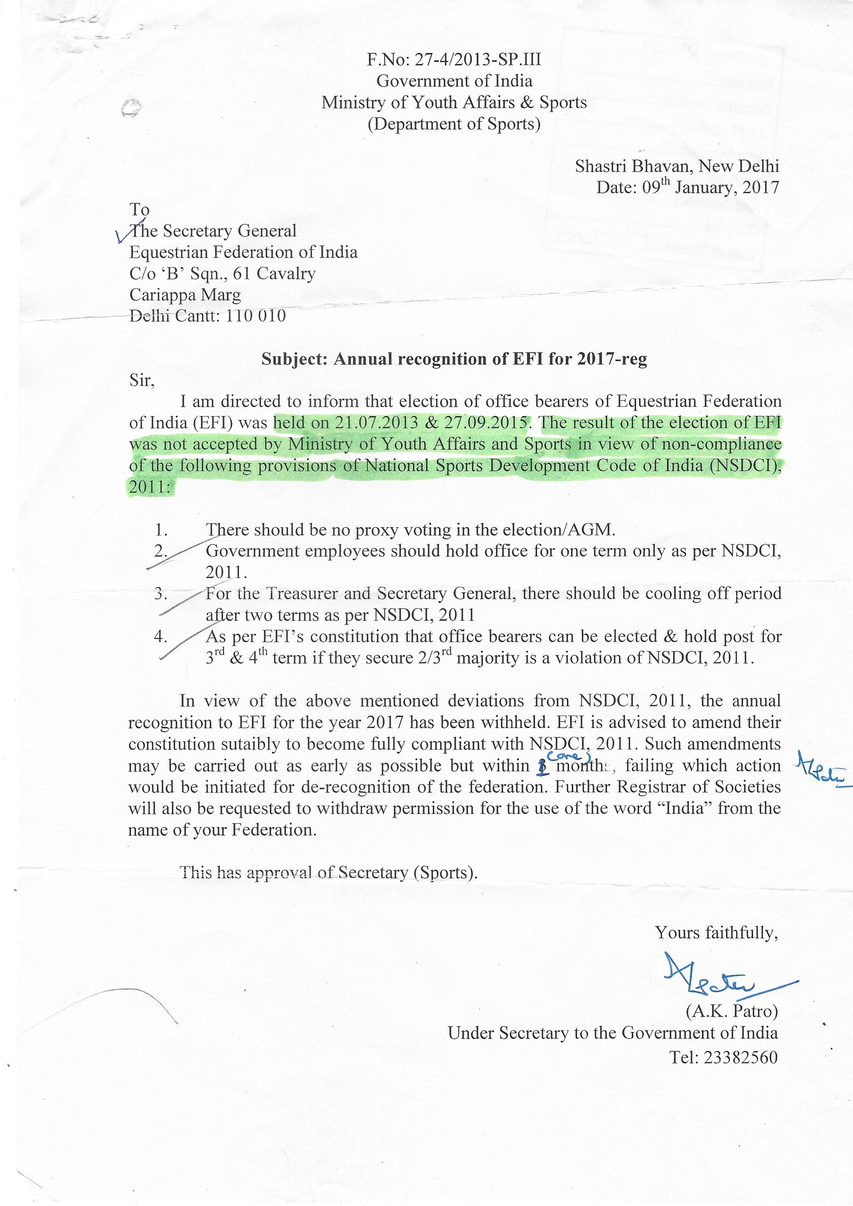

Slide 6

    ARTICLE 008 OF STATUTES :
    COMPOSITION (GENERAL ASSEMBLY)
THE GENERAL ASSEMBLY, IN SESSION UNDER THE STATUES, IS THE SUPREME AUTHORITY OF EFI.
THE GENERAL ASSEMBLY SHALL BE THE CONTROLLING BODY OF THE FEDERATION. ALL AUTHORITY IS VESTED IN IT AND DECISIONS OF THE ASSEMBLY SHALL BE BINDING ON ALL MEMBERS.
EACH STATE ASSOCIATION, INSTITUTION, CLUB OR UNIT MEMBER MAY BE REPRESENTED BY TWO DELEGATES (ONE AUTHORISED REP) AND HAS TWO VOTES. A MEMBER UNABLE TO SEND DELEGATES MAY NOMINATE AN EXISTING MEMBER TO ACT AS ITS PROXY. NO UNIT/INSTITUTION DELEGATE CAN HOLD MORE THEN ONE PROXY OF TWO VOTES IN ADDITION TO HIS OWN. AN INDIVIDUAL MEMBER HAS ONLY ONE VOTE AND CAN HOLD ONE PROXY VOTE FOR AN INDIVIDUAL MEMBER. THE PROXY (VOTING) AUTHORIZATION WILL BE SIGNED BY PRESIDENT OR SECRETARY/CO OR OC IN THE CASE OF INSTITUTIONAL/UNIT MEMBERS AND BY THE MEMBER HIMSELF IN THE CASE OF AN INDIVIDUAL MEMBER. A TERMINATED MEMBER WILL NOT BE ALLOWED TO REPRESENT ANOTHER MEMBER OF EFI (STATE ASSOCIATION / CLUB/ INDIVIDUAL).
HONORARY PRESIDENT, HONORARY VICE PRESIDENT AND OTHER HONORARY MEMBERS AND EX-OFFICO MEMBERS MAY ATTEND THE GENERAL ASSEMBLY WITHOUT VOTING RIGHTS.

Slide 7
IMPLICATIONS
4 YEARS DELHI TENURE FOR THE FOLLOWING APPTS AS IT IS OBLIGATORY FOR THEM TO BE DELHI BASED :-
SECY GEN
JT SECY (ADM)
JT SECY (TECH)
TREASURER
SELECTION COMMITTEE MEMBERS SHOULD BE APPOINTED BY EC AND NOT THROUGH ELECTION THIS REQUIRES STATUTE AMMENDMENT.
AMENDMENT OF ELECTION BYE LAW

Slide 8
    ARTICLE 015 OF STATUTES :
    SELECTION COMMITTEE ELECTION TENURE AND PROCEDURES
THE SELECTION COMMITTEE CONSISTING OF FIVE MEMBERS WILL BE ELECTED (NOMINATED) BY THE GENERAL ASSEMBLY (EXECUTIVE COMMITTEE). ONLY MEMBERS WHO HAVE WON MEDALS IN ANY OF THE EQUESTRIAN DISCIPLINES IN THE NATIONAL EQUESTRIAN CHAMPIONSHIPS ARE ELIGIBLE. THEIR TENURE WILL BE OF TWO YEARS DURATION. THEY CAN SEEK RE-ELECTION (BE NOMINATED) FOR ANOTHER TERM OF TWO YEARS BY SIMPLE MAJORITY (EXECUTIVE COMMITTEE). THE PRESIDENT SHALL NOMINATE THE CHAIRMAN OF THE SELECTION COMMITTEE TO CONDUCT THE PROCEEDINGS OF THE MEETING. ALL PROCEEDINGS WILL BE RECORDED. THE SECRETARY GENERAL CAN ATTEND MEETINGS BUT WITHOUT VOTING RIGHTS AND WILL RECORD ALL PROCEEDINGS AND OBTAIN SIGNATURE OFF ALL ATTENDING SELECTION COMMITTEE MEMBERS. SIGNED COPIES WILL BE SENT TO ALL COMMITTEE MEMBERS BY SECRETARY GENERAL WITHIN 10 DAYS OF CONVENING A MEETING. COPIES WILL ALSO BE SENT TO ALL EXECUTIVE COMMITTEE MEMBERS AND PLACED IN THE FEDERATION READING FILE.
IF A SELECTION COMMITTEE MEMBER DOES NOT ATTEND TWO CONSECUTIVE MEETINGS HE WILL CEASE TO BE A MEMBER AND THE PRESIDENT CAN NOMINATE ANOTHER SUITABLE EFI MEMBER TO MEET IMMEDIATE REQUIREMENT. A SUITABLE MEMBER WILL HOWEVER, BE ELECTED (NOMINATED) IN THE ENSUING GENERAL ASSEMBLY (EXECUTIVE COMMITTEE MEETING) TO FILL UP THE VACANCY. THE CRITERIA FOR MEMBERS SEEKING RE ELECTION TO THE SELECTION COMMITTEE WILL BE THE SAME AS STIPULATED IN THE STATUTES FOR EXECUTIVE COMMITTEE MEMBERS.

